Slide 1

AWS vs GCp vs AZURE
Cloud platforms comparison

Slide 2
overview
Amazon Web Services
Microsoft Azure
Google Cloud Platform
Founded in 2006
32% of market
Founded in 2010
23% of market
Founded in 2011
9% of market
69$ per instance
70$ per instance
52$ per instance

Slide 3
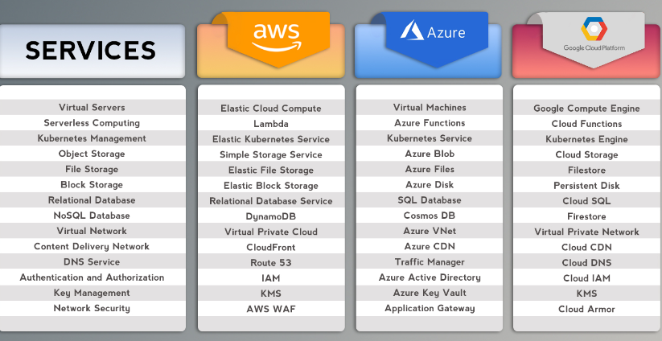

Slide 4
Real life examples
AWS
Netflix
Coursera
Airbnb
Azure
Bosch
Audi
Starbucks
GCP
Toyota
Spotify
Paypal

Slide 5
Which cloud platform to choose ?
AWS
When you need wide range of services
To make use of global presence of their extensive network
Azure
Integration with Microsoft ecosystem
To maintain secure hybrid cloud system
GCP
It provides high-performance to maintain and analyze big data

Slide 6
Thank you

